Slide 1


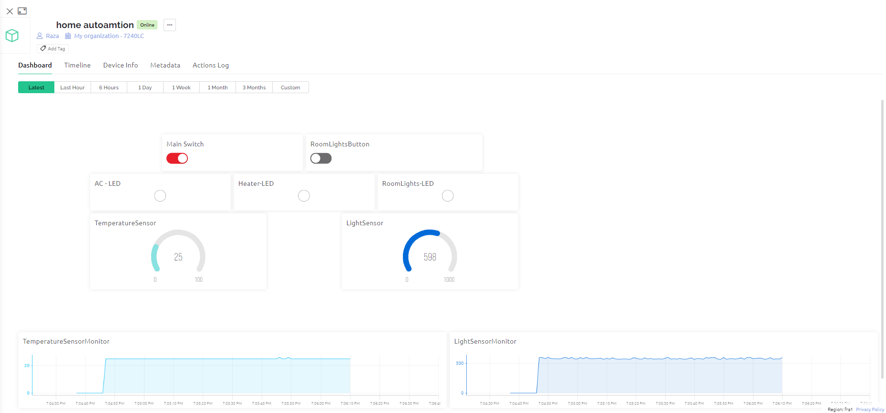


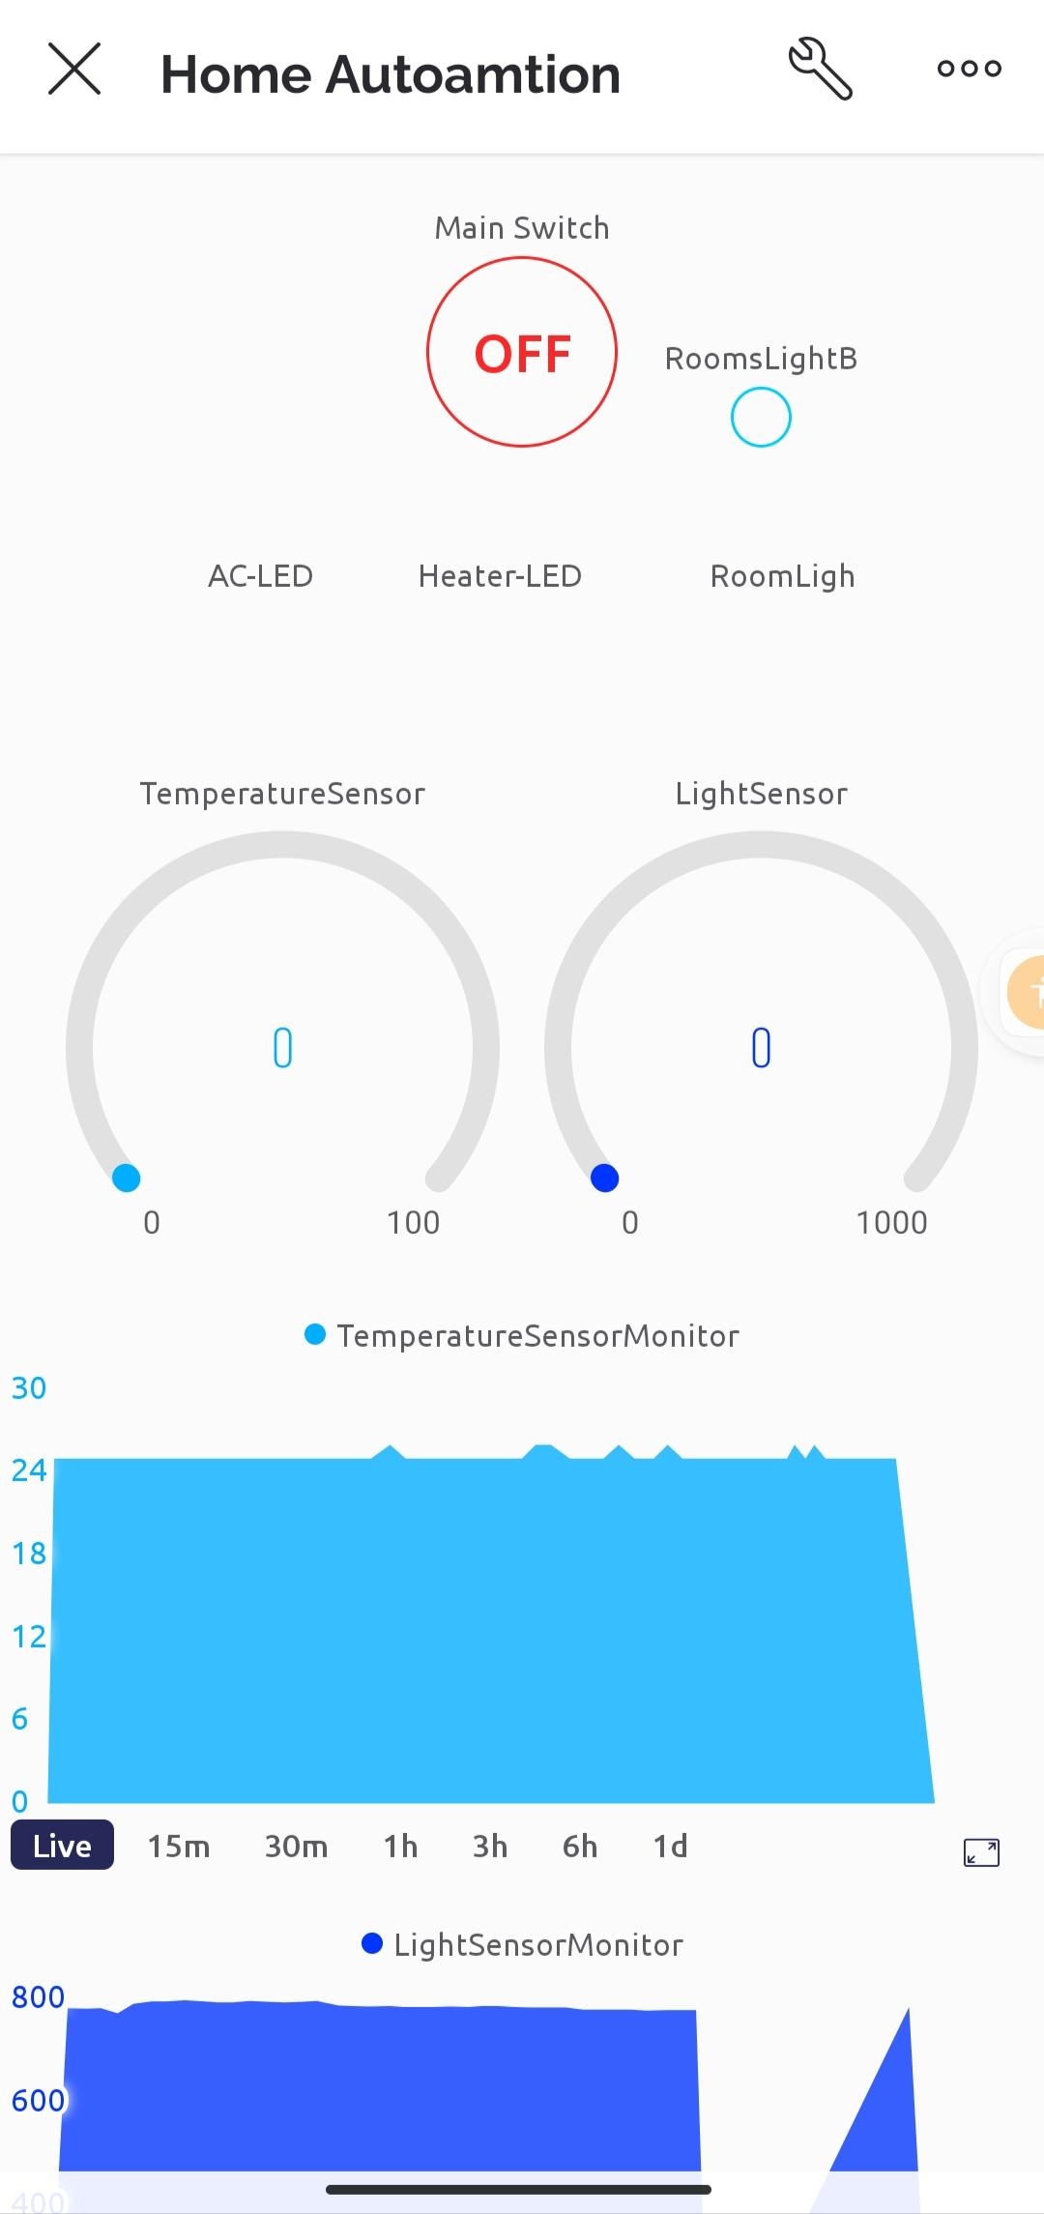
Home Automation
IOT Arduino Based Home
Automation solution
Submitted to
Prof: Maurizio Palesi
Submitted By
Raza Akbar
Adeel Adeel

Slide 2
Outline
Room Automation
Components
Circuit
Blynk Dashboards
Arduino Code
TinkerCad Example

Slide 3
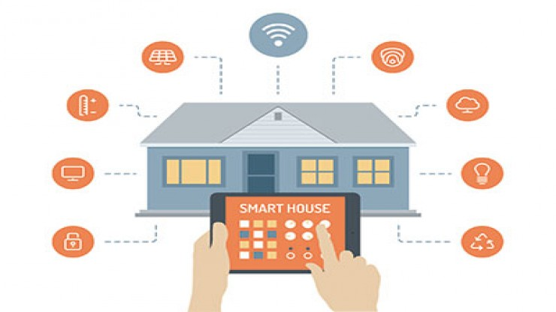
Room Automation
Room automation is constructing automation for a domestic, mentioned as a sensible home or smart house. In the IoT Room automation ecosystem, you can control your devices like light, AC, Heater fan, TV, etc.

Slide 4
Room Automation
Goals:
The goal of our project is to control some devices using IOT technologies based on Arduino.
We automate the room heater, Air conditioner and lights. We also enable the display of the room temperature.
We have designed the complete circuit using arduino and implemented the programming system for the automation.

Slide 5
Specifications
In our project we used an Arduino Yun IOT device, Breadboard and some other components to make it and connect it with Blynk-web and Blynk Android application.
This IoT device automates the Light, Air-Conditioner and Heater according to surrounding temperature.
We build a Web and Android dashboard to monitor it and control the working of device using Blynk IoT platform.

Slide 6
Specifications
We can made an Room-Home Automation in Hardware as well as on Blynk IoT Platform.
With the help of some (Components and Blynk IoT) we made a successful circuit which automates a room light, air condition and heater.
Light sensor help us to sense the intensity of our surrounding light, If the light intensity is less than (30) then room light is automatic (ONN) else light is (OFF).
And also we implement a Direct button for light, for example if the light intensity is not less than (30) and we want to (ONN) the light, it is also possible.

Slide 7
Specifications
And Temperature sensor help us to tell about the surrounding temperature, If the temperature is Greater than (30) then Air condition is automatic ONN and If the Temperature is less than (25) then Heater is (ONN).
The Temperature between 25 and 30 we considered as a normal temperature.

Slide 8
Components
Name of Component | Quantity
Arduino Yun | 1 (One)
Temperature Sensor | 1 (One)
Light Sensor | 1 (One)
LEDs | 3 (Three)
Resisters | 5 (Five)
BreadBoard | 1 (One)
LCD 16x2 | 1(One)
Wires | Some connection wires
1
The detail list of Components is mentioned here.

Slide 9
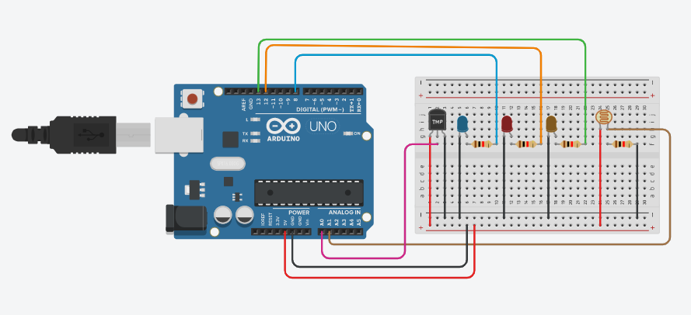
Circuit
1

Slide 10
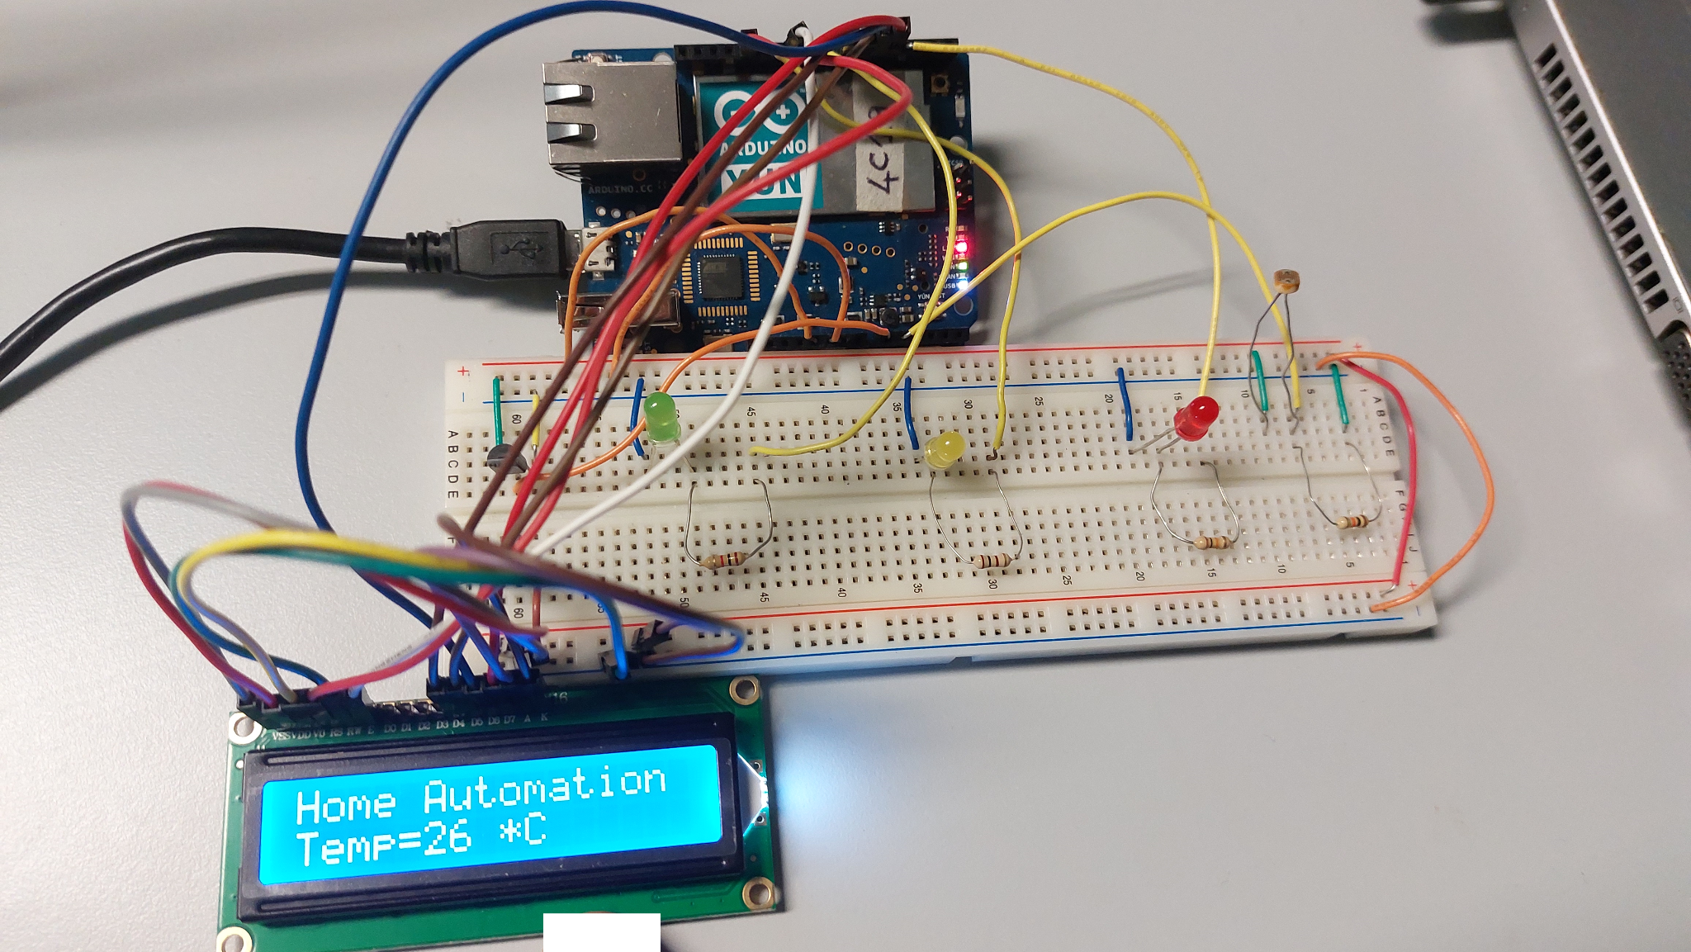
Circuit
1

Slide 11
Web Dashboard
1

Slide 12
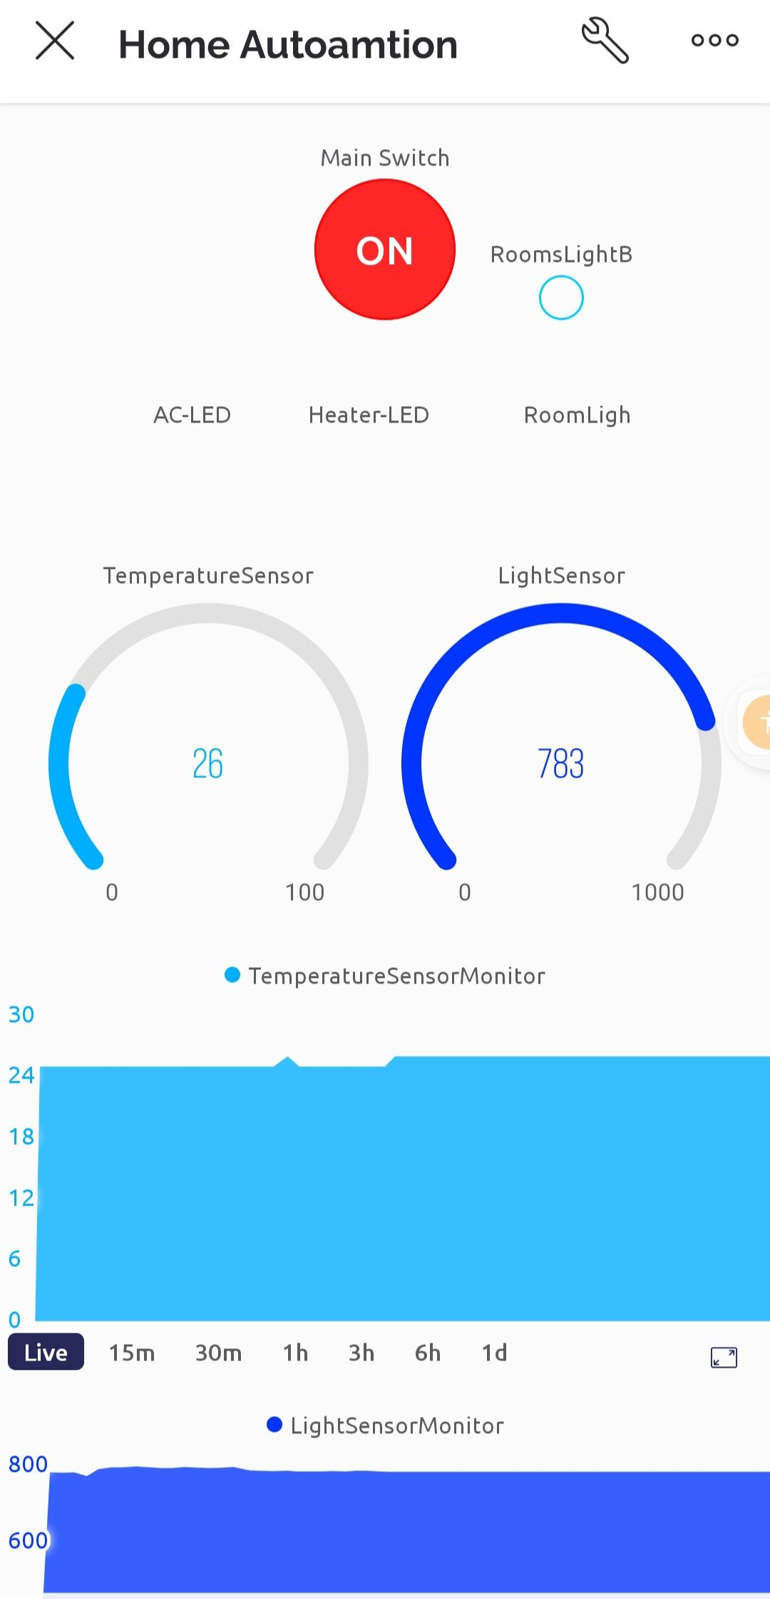
Mobile Dashboard

Slide 13
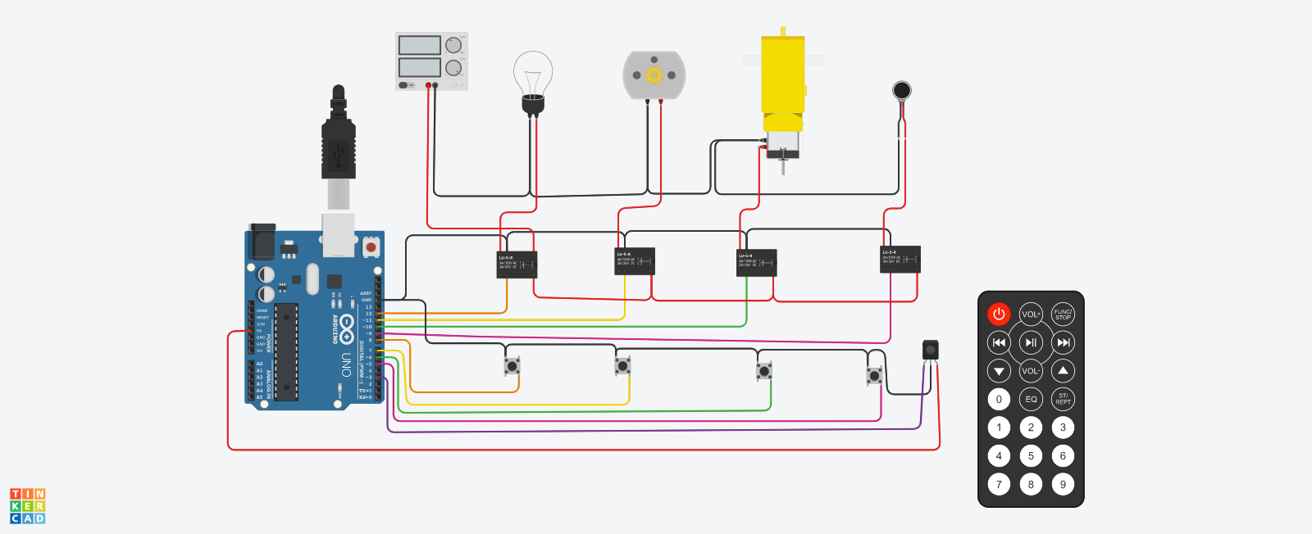
TinkerCad Project
Arduino based IR Remote and Manual Home Automation

Slide 14
Description
In our virtual project we made a home automation of some common home appliances which we can control by manually as well as remotely. In this we used some relay SPDT, some buttons and some common appliances.
Usually we can control our room appliances by manually but in this project our goal is to made a circuit where we can control our appliances manually as well as remotely.

Slide 15
Questions?

Slide 16

THANKS

